Slide 1
Group 7 – Virtualization
Cryptography & Network Security
BTech ETT (Year 4, ULK)

Slide 2

Learning Objectives
Understand virtualization in telecom & IT
Types: server, network, storage
Know risks & security issues
Plan disaster recovery & incident response
Apply to real-world companies

Slide 3


Case Description
Small & medium businesses need reliable IT at low cost
Use virtualization (VMs & containers) instead of many servers
Benefits cost-effective, easy to expand, fast to manage.
Risks hypervisor attacks, VM sprawl, data leakage.

Slide 4
Types of Virtualization
Server: Many OS on one machine (KVM, VMware)
Network: Software replaces firewalls, routers (NFV)
Storage: Combine devices into one logical system
Example: running VPN, firewall, core services as VMs

Slide 5
Security Concerns
Hypervisor attacks → patch & harden
VM sprawl → manage lifecycle
Shared resources → segmentation & encryption
Insider threats → RBAC & MFA

Slide 6
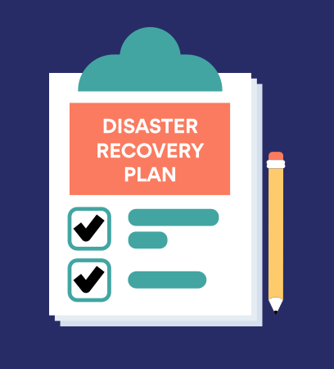
Disaster Recovery Plan
Regular backups (VM snapshots)
Redundancy across sites
Failover to other servers
Regular testing & drills

Slide 7
Incident Response Plan
Detect → monitor logs
Contain → isolate VMs
Eradicate → remove threat & patch
Recover → restore clean backups
Learn → improve policies

Slide 8

Discussion Questions
Benefits of virtualization in telecom?
Risks vs physical systems?
How to secure hypervisors?
VM vs container – which is better?
How does DR change with virtualization?

Slide 9
Conclusion
Virtualization saves cost, adds flexibility, and speed
New risks must be managed
Security, DR, and incident response are essential
With good planning, companies gain more benefits than risks

